Slide 1
Capstone Project - The Battle of Neighborhoods
Opening Restaurant in Ottawa, Canada
August 19, 2020

Slide 2
Introduction
Ottawa is the capital city of Canada. As a city with high quality of living, there are many people relocating to Ottawa every year.
If a newcomer looking to open a restaurant, where would be a good place?
Leverage the Foursquare location data to help the business owner to find an optimal place to open a restaurant.

Slide 3
Data Source
A list of neighbourhoods in city of Ottawa.
https://en.wikipedia.org/wiki/List_of_neighbourhoods_in_Ottawa
Coordinates of the neighbourhoods were generated using geocoder in python.
Collected the venues information(including restaurant type, location etc.) using Foursquare API.

Slide 4
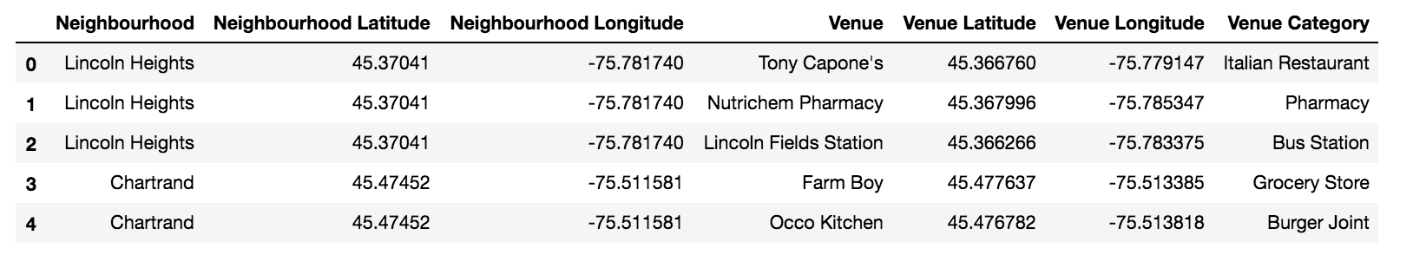
Data Cleaning
Neighbourhood names, coordinates, and their venues were merged into one data frame.

Slide 5
Exploratory Data Analysis
A summary of number of restaurants in each neighbourhood
Only neighbourhoods which contain no less than 5 restaurants were taken into consideration.

Slide 6


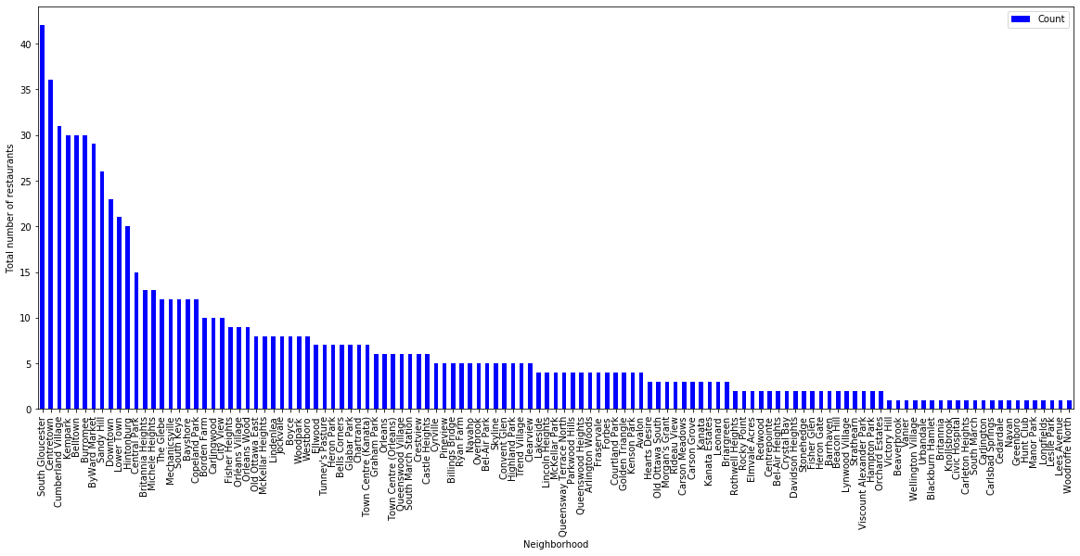
Exploratory Data Analysis

Slide 7
Methodology
Restaurants with similar type of cuisine opening proximity to each other will form a “restaurant zone”.
Cluster our neighbourhoods into groups based on similar characteristics(Most common restaurants).
K-means Algorithm - Unsupervised clustering method. Examples within a cluster are very similar to each other, while examples across clusters are very different.
Group the neighbourhoods which have restaurants with similar type of cuisine together.

Slide 8
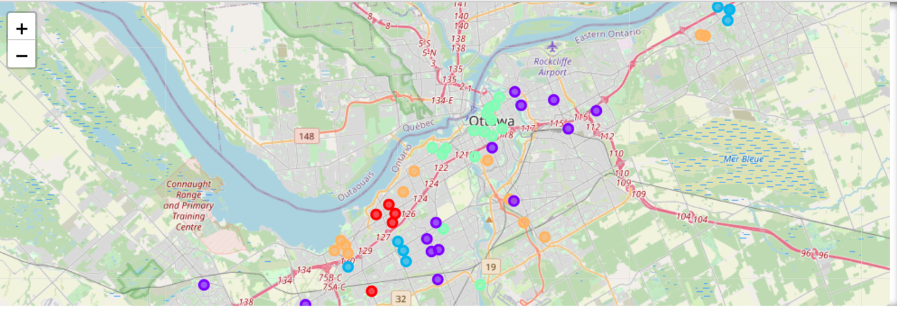
Results
Choose K= 5, a total of 58 neighbourhoods were analyzed.

Slide 9
Discussion
Select top 1, 2 and 3 most common cuisine in the neighbourhood for each cluster respectively; and merge them together to determine the major cuisine type as recommendations.
Cuisine type are summarized for each cluster.

Slide 10
Discussion
 | Cuisine Type | Number of neighbourhoods
Cluster 0 | Chinese Restaurants | 5
 | Thai Restaurants | 3
Cluster 1 | Fast Food Restaurants | 10
 | Mexican Restaurants | 8
 | Italian Restaurant | 3
 | Seafood Restaurant | 3
 | Asian Restaurant | 3
Cluster 2 | Fast Food Restaurant | 8
 | BBQ Joint | 3
 | Vietnamese Restaurant | 3
Cluster 3 | New American Restaurant | 5
 | French Restaurant | 5
 | Vietnamese Restaurant | 5
 | Mexican Restaurant | 3
 | Asian Restaurant | 3
 | Sushi Restaurant | 3
 | Tapas Restaurant | 3
Cluster 4 | Middle Eastern Restaurant | 8
 | American Restaurant | 3
 | Indian Restaurant | 3
 | Turkish Restaurant | 3

Slide 11
Conclusion
The distribution of restaurants in Ottawa forms several “restaurant zone”. Grouping the neighbourhoods based on their ‘restaurant characteristics’ effectively helped us finding out “restaurant zone”. These information serves as the valuable indications for those new comers coming to Ottawa who want to open a restaurant.

